Slide 1
DHRT SVM
Topic : FEES DEPARTMENT
Submitted To: Mrs. Sudha Saras
Created By SATYAM VATS

Slide 2
CONTENTS OF THIS PRESENTATION
Requirement & Uses of this Software
Sites used for Help
System Requirements
Source Code
Output

Slide 3
REQUIREMENTS & USES of this Software
REQ. #1
REQ. #2
REQ. #3
USE #1
USE #2
Entering a large no. of Data in Registers found Difficult & less Precise.
Data Stored in Registers took much time to find out a single Record.
Data Entry in some special Software require professional skills
Can be Use to Enter/Fetch Details more Easily with accuracy
Soft Data does not require large 3D space & are stored in Servers.

Slide 4
SITES USED FOR HELP PURPOSE
GeeksForGeeks
StackOverflow
MORE
google.com
I was favored by this site for some basic tkinter errors (like: _tkinter.TclError) that I used to get while working on Program for the very first time.
Stack Overflow is used for some new Packages used while Making the Software viz. “pyinstaller”
docs.python.org
youtube.com

Slide 5
SYSTEM REQUIREMENTS
MINIMUM
RECOMMENDED
Python v3.1
My SQL Sever 5.7
RAM – 2GB
Resolution – 1280x720
OS – Windows 7 (x64)
Python v3.1 (or higher)
My SQL Sever 8.0
RAM – 4GB (or higher)
Resolution – 1280x720
OS – Windows 10 (x64)

Slide 6
SOURCE CODE
Codes are shown as Screenshots of Python -IDLE

Slide 7
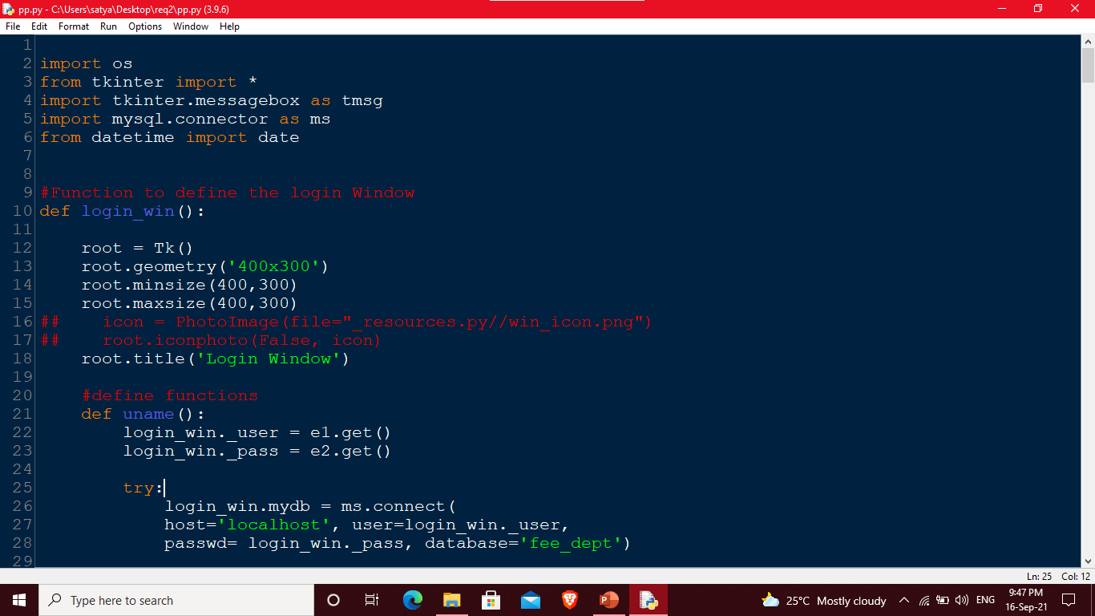

Slide 8
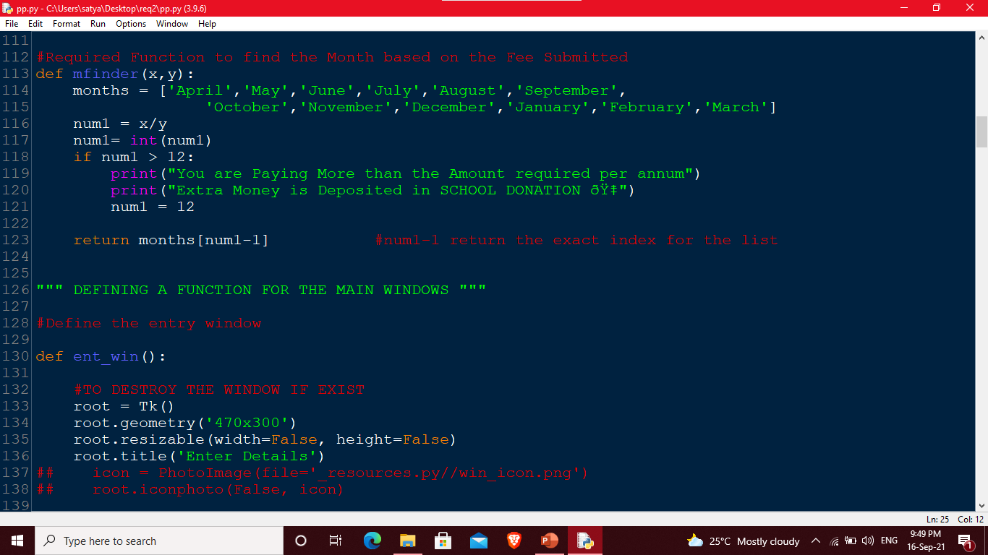

Slide 9
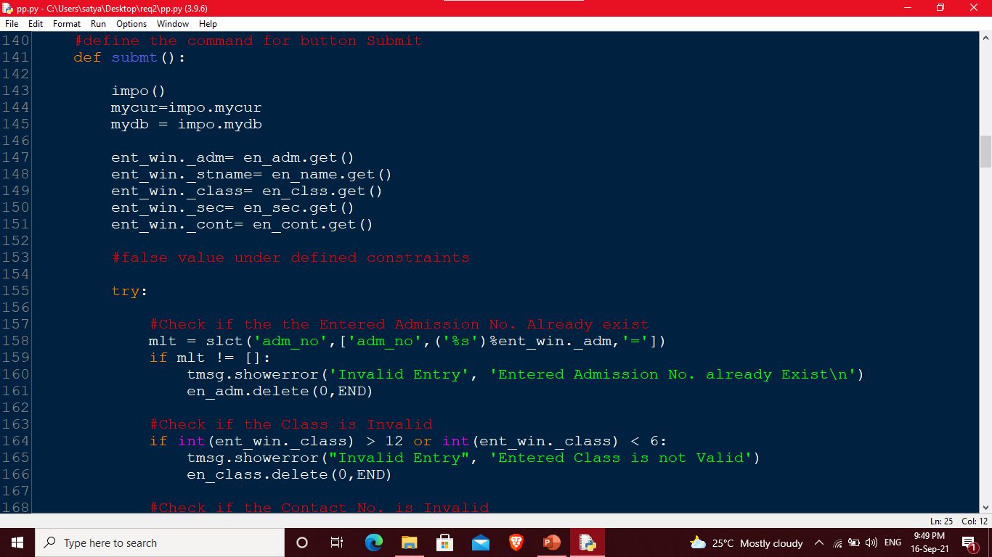

Slide 10
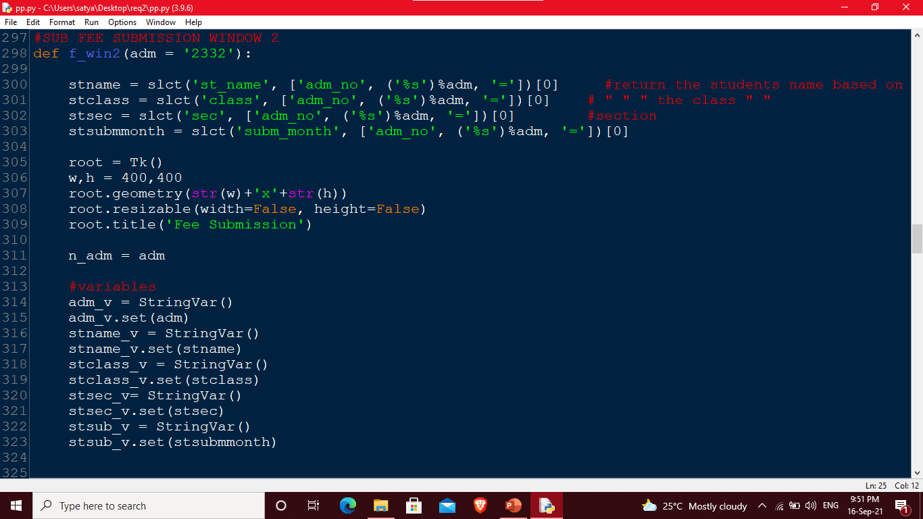

Slide 11
OUTPUT
Output is shown as Screenshots of Python Launcher

Slide 12
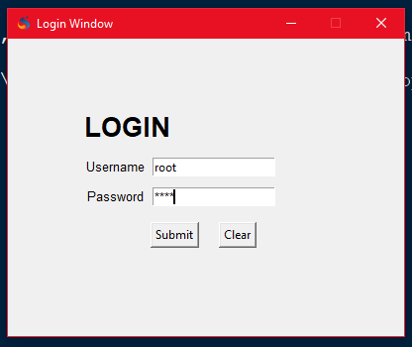

Slide 13
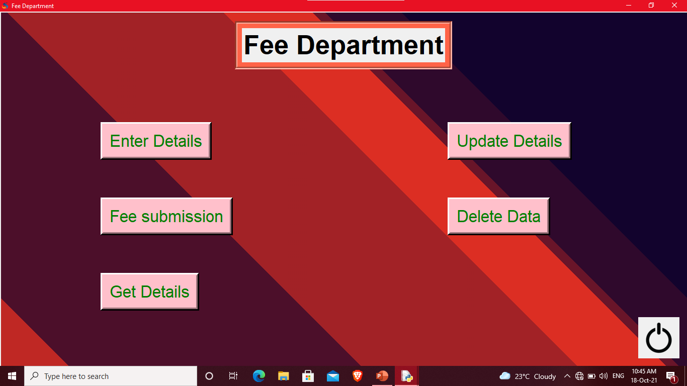

Slide 14
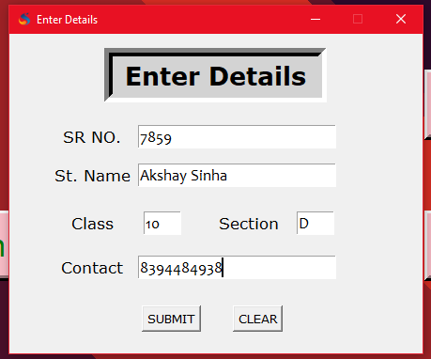
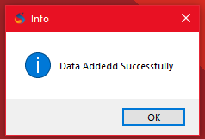

Slide 15
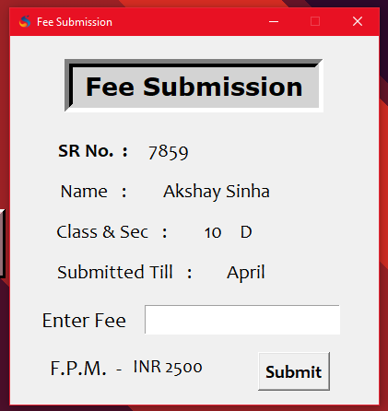
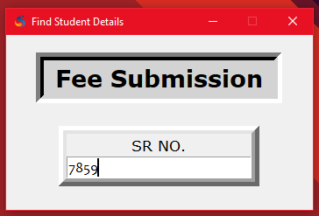

Slide 16
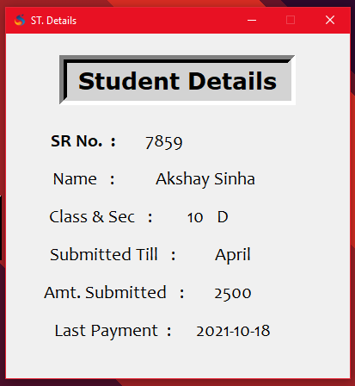
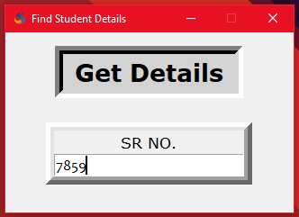

Slide 17
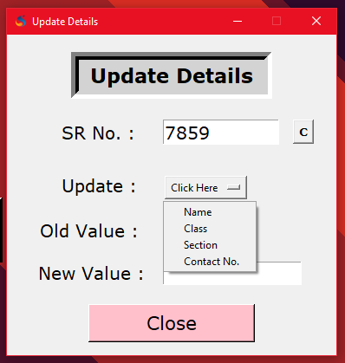
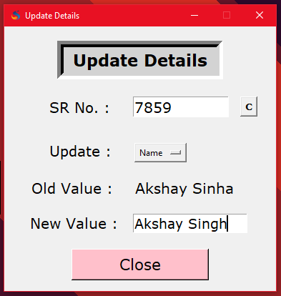

Slide 18
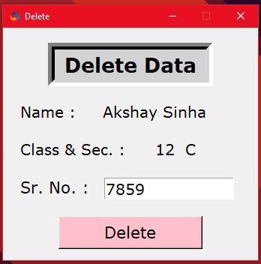
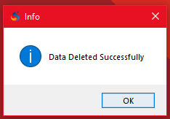

Slide 19
17
09
21
THANKS
Presented By SHIVAM SHARMA & SATYAM VATS

Slide 20
-
-
21
THANKS
Presented By
SATYAM VATS

